Slide 1
Daily Paper Reading
Wendong Chen
12/02/2019

Slide 2
Faster R-CNN
Topic
Background;
Network architecture;
RPN, anchor;
Implementation;
Analysis.

Slide 3
Background
Computational bottleneck for SPPnet/Fast R-CNN
Selective search: 2 seconds per image for proposals
EdgeBoxes: 0.2 seconds per image for proposals
RPN: 10 ms per image for proposals, 5 fps for dectection

Slide 4
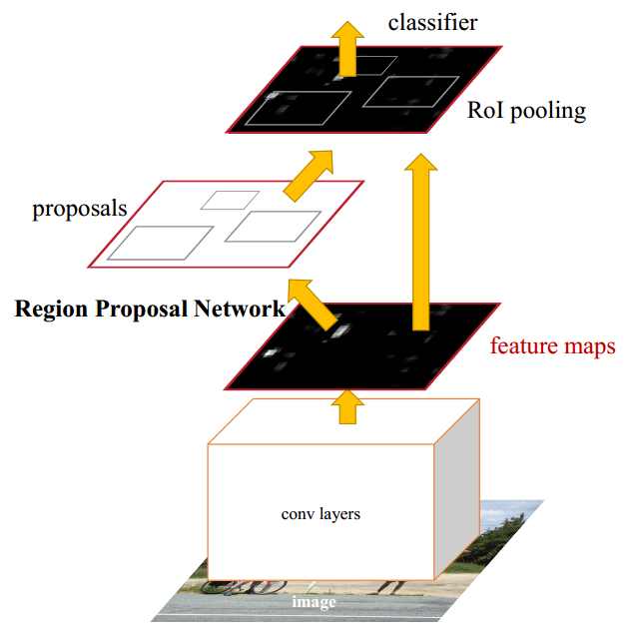
Network architecture
Backbone
RPN
Fast R-CNN
Image
Feature maps
Proposals
Results
RPN: filter size 3*3, padding 1, stride 1
Cls: filter size 1*1, stride 1, kernel number 2k
Reg: filter size 1*1, stride 1, kernel number 4k

Slide 5
RPN
Region proposal network
Filter size 1*1, stride 1
Kernel number 18 for classification
Filter size 3*3, padding 1, stride 1
Receptive field 171/228 pixels for ZF/VGG
Kernel number 256/512 for ZF/VGG
9 anchors for each location
Filter size 1*1, stride 1
Kernel number 36 for classification

Slide 6
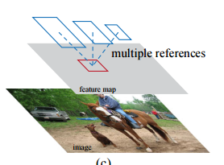
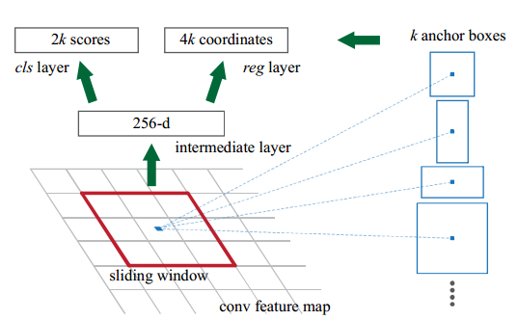
Anchor
9 anchors for each location
3 scales and 3 aspect ratios
128², 256², 512²
1:1, 1:2, 2:1
Positive: IOU > 0.7 and max IOU with GT
Negative: IOU < 0.3
Image size 1000*600
Last feature map size ~ 60*40
So totally ~ 60*40*9 anchors

Slide 7
Implementation
4-Step alternating training
RPN
Fast R-CNN
Fine-tune RPN
Fine-tune Fast R-CNN

Slide 8
Implementation
Only train the anchors in the center.
RPN
NMS
6000 anchors
6000 proposals
2000 proposals
0.7
Training: 2000 proposals
Test: top-N cls ranked proposals
Fast R-CNN
NMS: 0.7
2000
2000
proposals
results
proposals
top-N
top-N
score>thres

Slide 9
Experiments
Model size;
Feature generalization.
Deeper depth, larger training set

